Slide 1
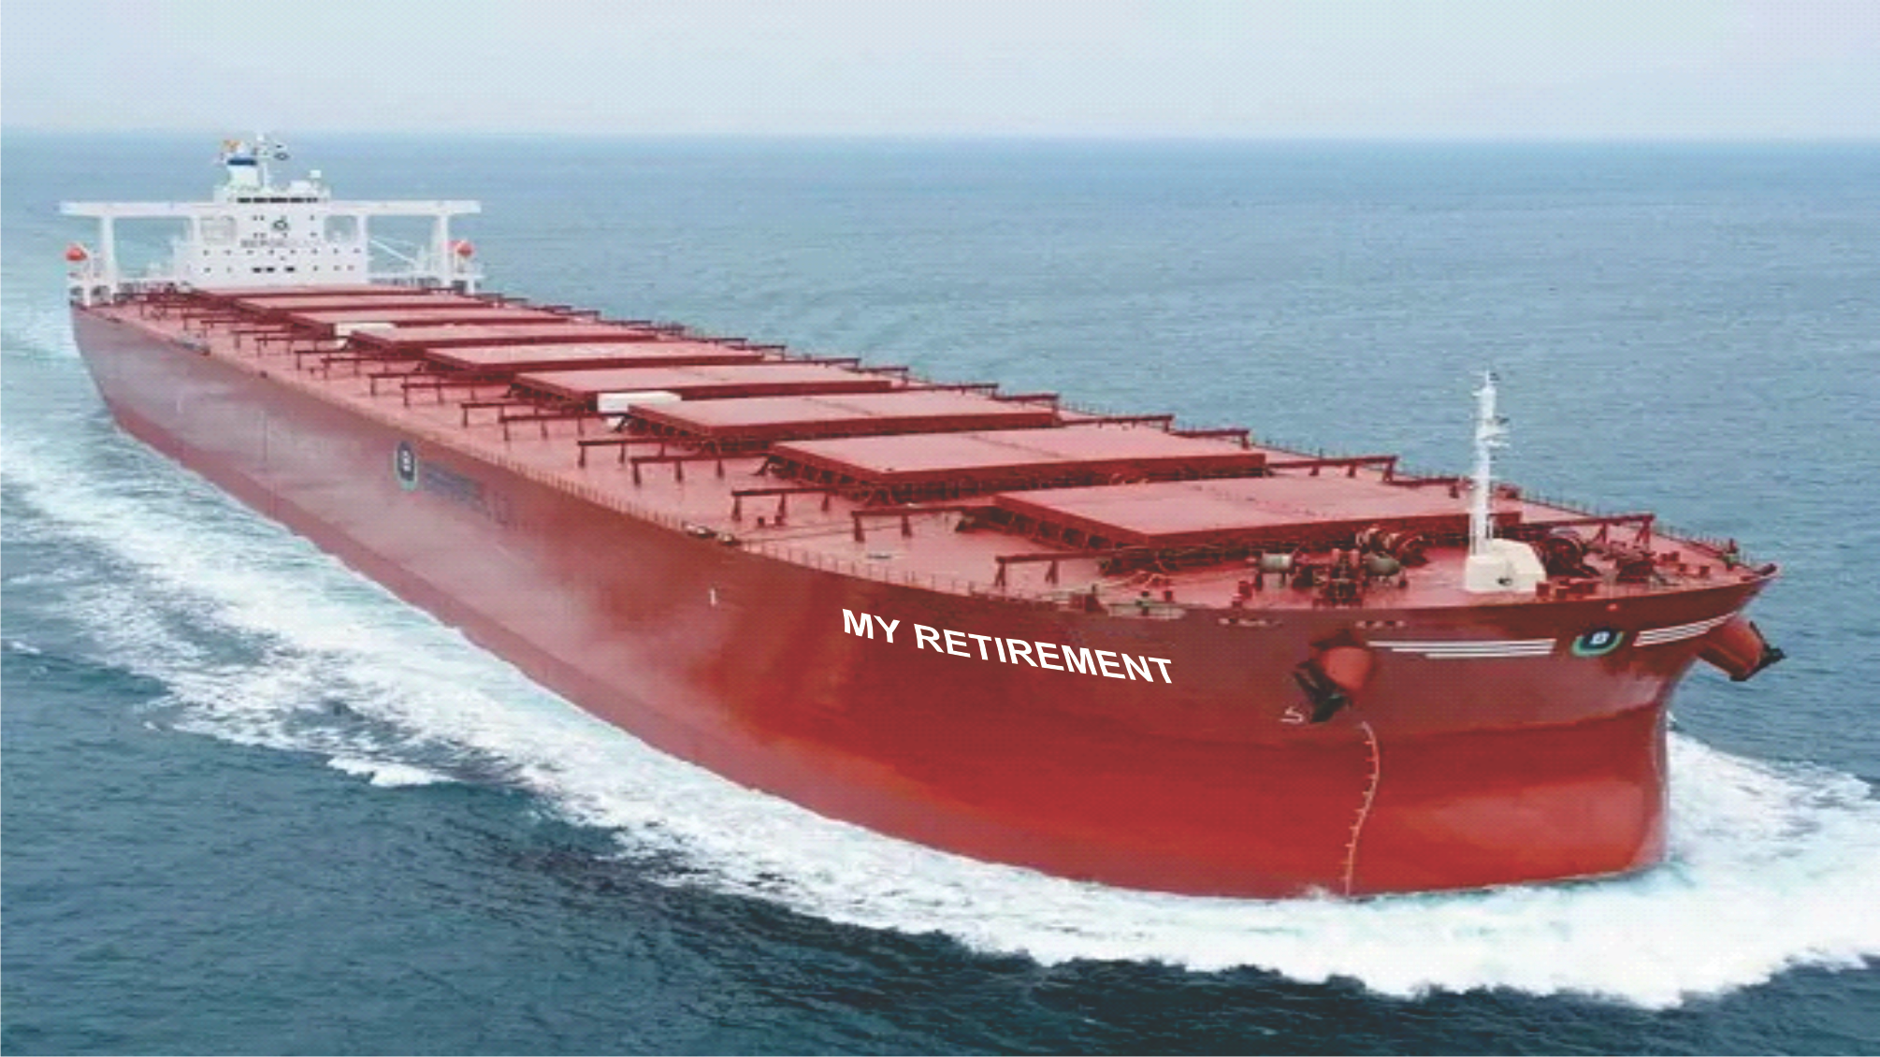
The HARBOR PILOT
Notes:
I call this story The Harbor Pilot.

Slide 2
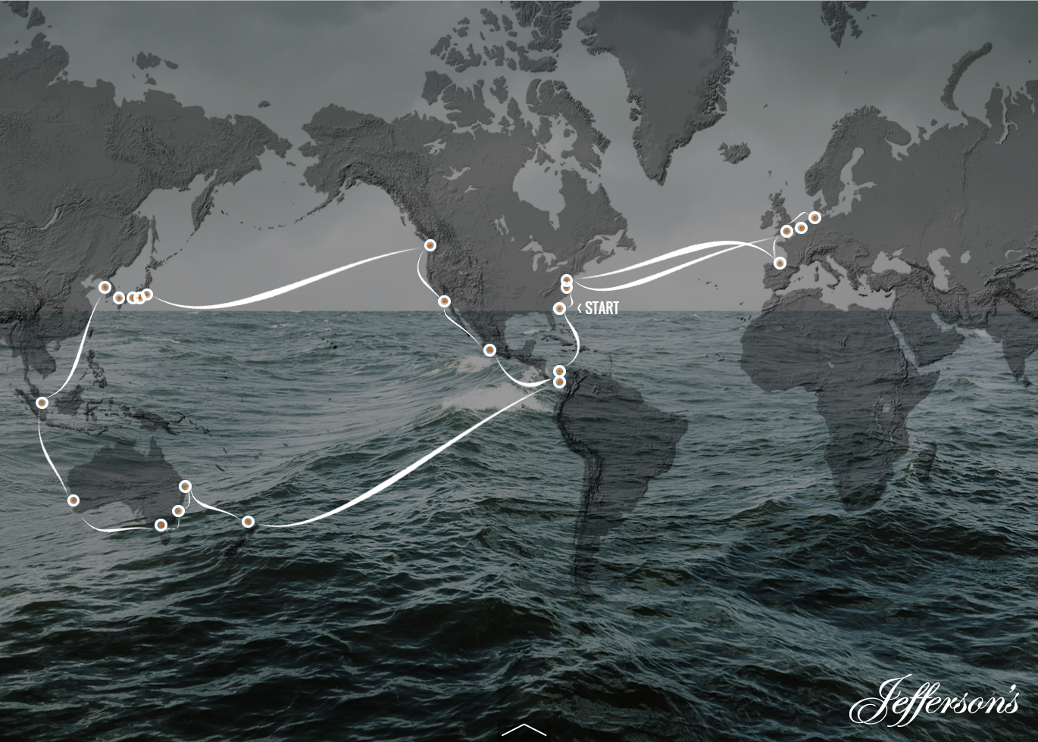
Investing is a journey
You’ve been saving for many years
It’s taken sacrifice
Hard work
Discipline
Skill
Notes:
Investing is a journey of many years…even decades in many cases. It’s a journey that might take you to many interesting places. And it’s taken sacrifice, hard work, discipline and skill to navigate.

Slide 3
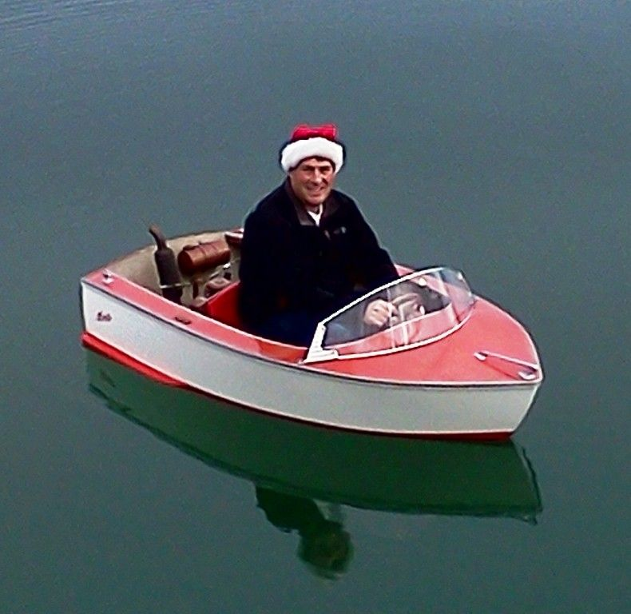
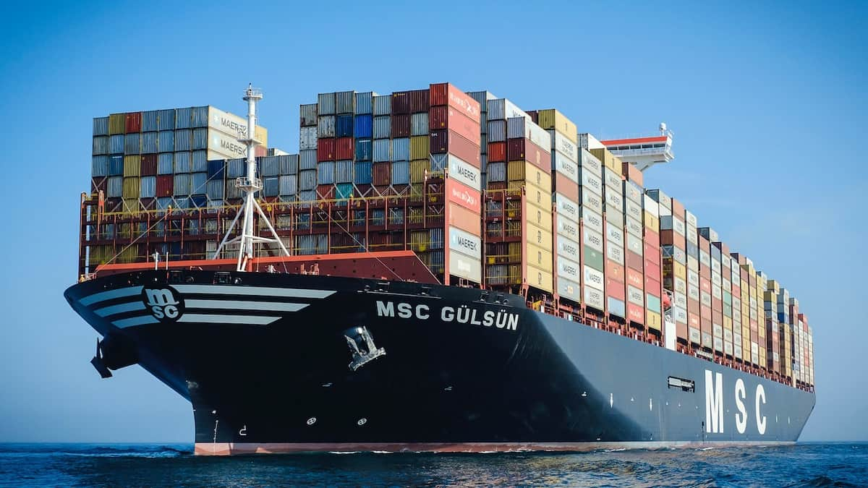
But what started as this
Has now become
Notes:
What started out as THIS…has now become this.

Slide 4
And as you approach retirement…
It’s time to call for…
A Harbor Pilot
Notes:
And so as you approach retirement, it’s time to call for a harbor pilot. BTW…it the real world this is mandated by maritime law. The minimum size requirement varies by the port but generally any ship over 100 tons must have a harbor pilot on board.

Slide 5
So what is a HARBOR PILOT?
A highly trained specialist
With advanced skills & experience
One critical job
Get the ship safely home!
Notes:
So what exactly is a harbor pilot. It’s a specialist with advanced skills and experience who’s job it is to get that ship safely into the port. They are experts in the most dangerous and complex part of the journey.

Slide 6
The reason you need a Harbor Pilot
As you get closer to retirement…
You have more to protect
The skills are different
The risks are greater
And one mistake could sink your ship
Notes:
And retirement is exactly the time you need one the most.

Slide 7
Most of the investment journey has been in the open ocean
And it looked like this…
Notes:
You know, most of your investment journey has been on the open ocean and pretty much it looked like this most of the time.

Slide 8
Sometimes there were scary storms
Notes:
Sure…there were occasional storms

Slide 9
Icebergs

Slide 10
Rogue waves

Slide 11
Pirates

Slide 12
Giant squid

Slide 13
But most of the journey was pretty calm
As proof…
You invested $50,000 in 1983
Got amnesia in an accident.
Totally forgot about this money.
Until they cured you in 2002!
Today you would have…
$3.3 million!
Notes:
But most of the journey was pretty calm. If you want proof…
Imagine that you invested $50,000 in 1983 in the S&P 500. And then somehow you got amnesia and totally forget you had this money in the stock market. Then 40 years later you snapped out of it and suddenly remembered that you had put that money away. So you called Vanguard and asked to see a statement. You would have $3.3 million dollars today.
If all you did was leave the money alone for 39 years, you would be a multi millionaire today. You didn’t have to trade the market, you didn’t have to worry about bear markets. You didn’t have to worry about the Dot Com Bust or the 1987 Crash or inflation, recession, the housing bubble…nothing! If you just left the money alone you would be a multi-millionaire.
The S&P 500 over that time period is up over 3000%. That’s how calm the open ocean journey can be if you just leave the money alone…but most people don’t do that, obviously. Most people move things around which is a disaster. And frankly, many financial advisors have a vested interest in keeping your money moving. But we’ll save that for another discussion.

Slide 14
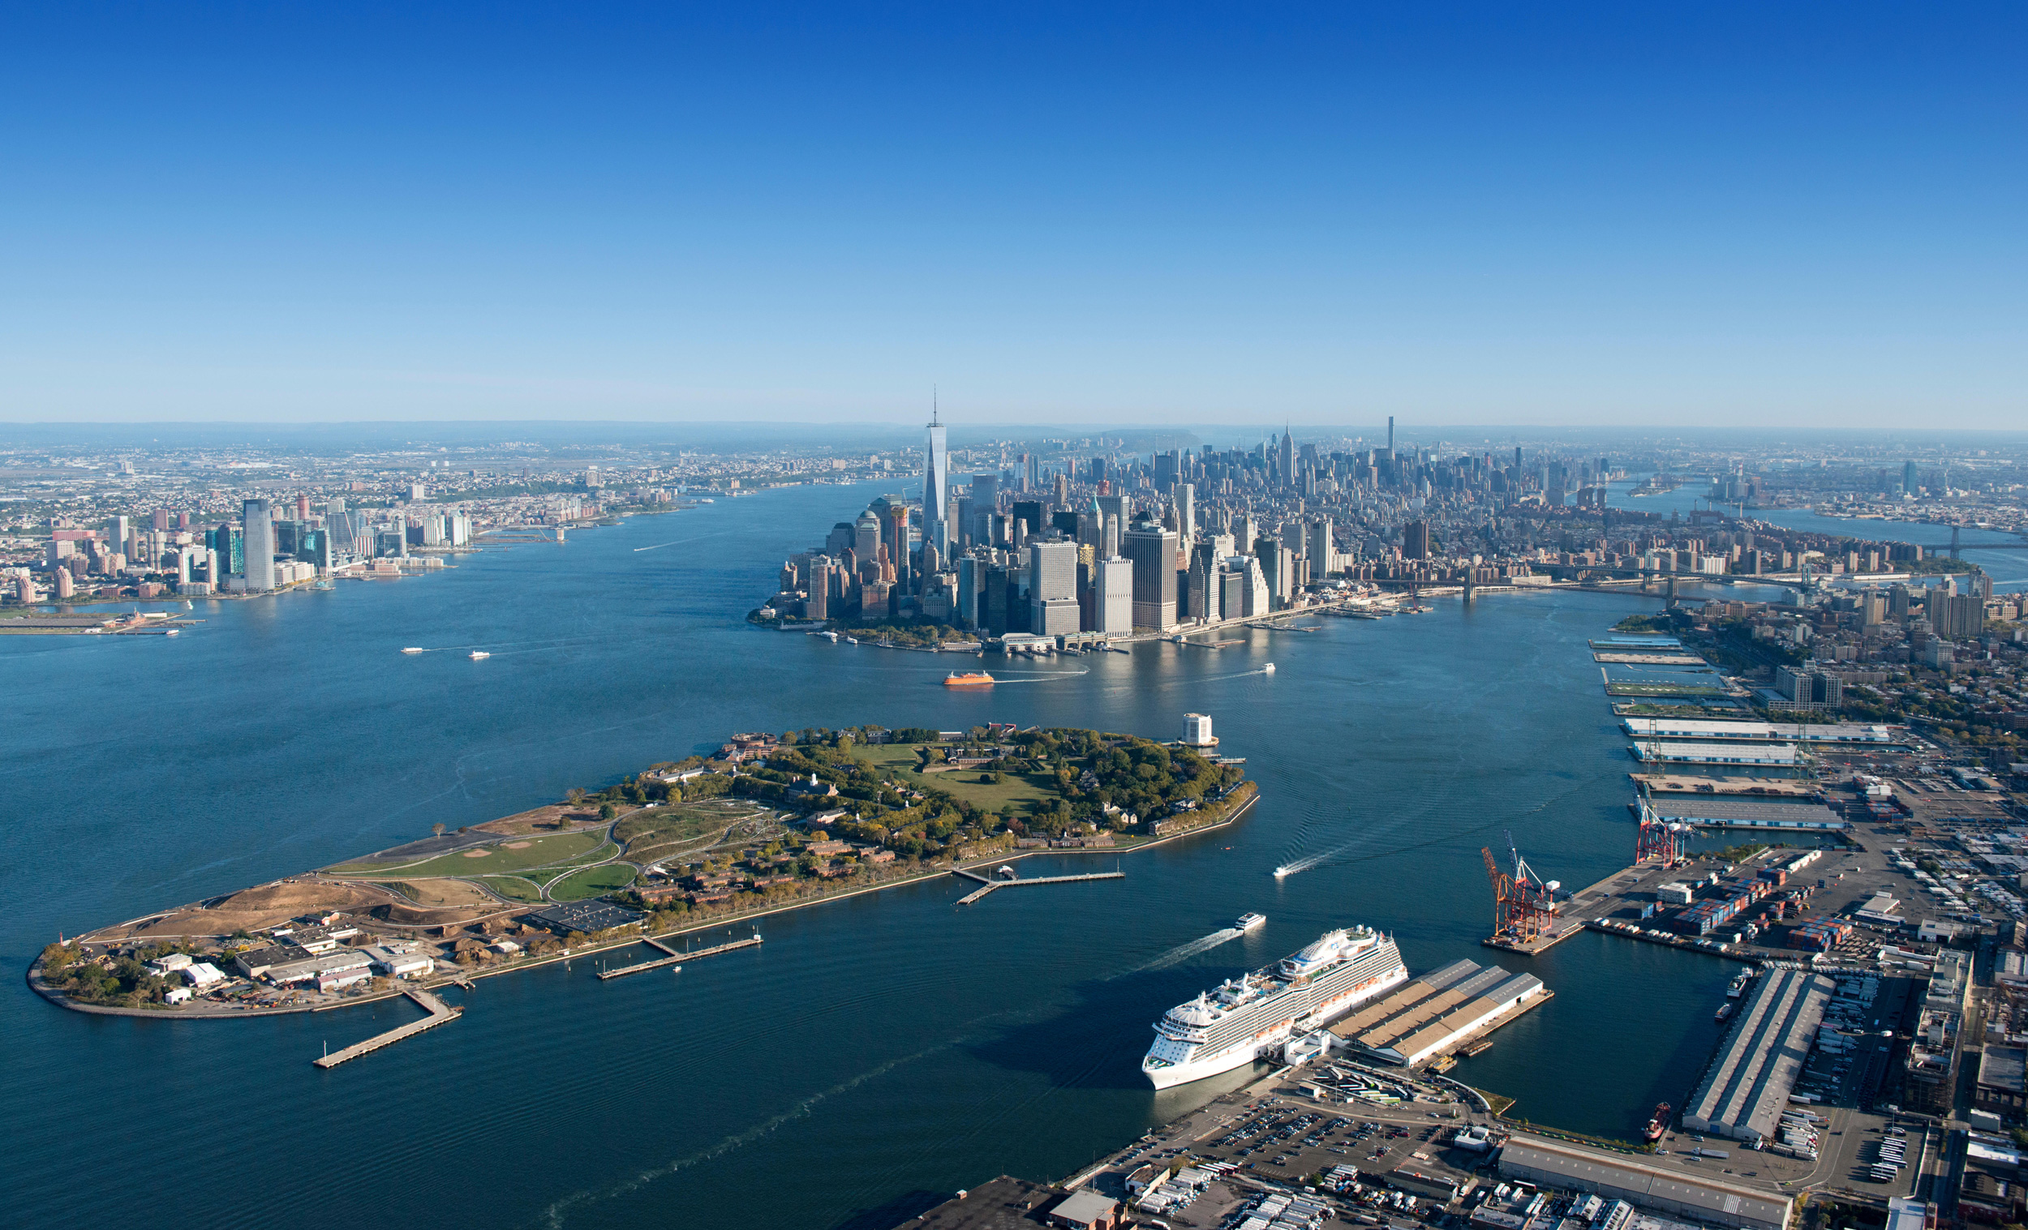
10X more danger in the harbor!
Shifting tides
Relative wind
Other boats
Sand bars
Bridges
Narrow channels
Rocks
Cables
Sunken ships
Notes:
The bottom line is this: In the harbor there’s 10 times greater danger! (read slide)

Slide 15
As you approach the harbor you
lose your greatest partner
in the journey
TIME
To keep growing your portfolio
To absorb market corrections
To recover from bad decisions
To defer taxes
Notes:
And the one thing that’s been your greatest partner on the journey is gone. TIME! There’s little time left to…(read slide)

Slide 16
I am a specialist in Retirement Planning
Specific tools
Techniques
Training
Experience
To navigate the most important and dangerous part of your journey!
Notes:
Why am I telling you this Harbor Pilot story. Well because that what I am! I am a specialist in retirement planning. I’m the expert who helps you get your ship safely into port. I have the tools, techniques, training and experience to navigate the most important and dangerous part of your financial journey.

Slide 17
Schedule a 15-minute “Mini-Consult”
Size doesn’t matter!
Phone, Zoom, or in person
Totally free!
Ask any questions on your mind
Notes:
So I’m asking you to schedule a free 15 minute mini-consultation.
Size doesn’t matter. I don’t care if you have a two person rowboat or a million ton container ship. You came to my workshop tonight and I am committed to help you.
We can do it over the phone, on Zoom or in person…whatever you prefer.
It’s totally free and you can ask any questions on your mind.

Slide 18
Do I have enough to live on?
How much income will I need?
Should I keep working longer?
When should I take Social Security?
How will inflation affect me?
How can I guarantee my income?
How can I make sure my spouse is protected?
Should I buy crypto? (NO!)
Should I sell my home & downsize?
Should we pay off our mortgage?
Do we need LTC insurance?
Notes:
Some of the more common questions I’ve heard might be ones that you have too. (read slide) There are a thousand possible questions you might have that are specific to your situation and I’ve probably heard most of them. And if I don’t have an answer I know where to get one. Because this is what I do every single day.

Slide 19
You’ve worked hard for a long time to get where you are.
But it’s a NEW GAME in retirement!
Let me help you get safely home!
Notes:
Look…you worked hard for a long time to get where you are. You’ve earned the right to enjoy this amazing time in your life. Retirement…does not have to be scary…it can be fantastic! But it is a new game.

