Slide 1
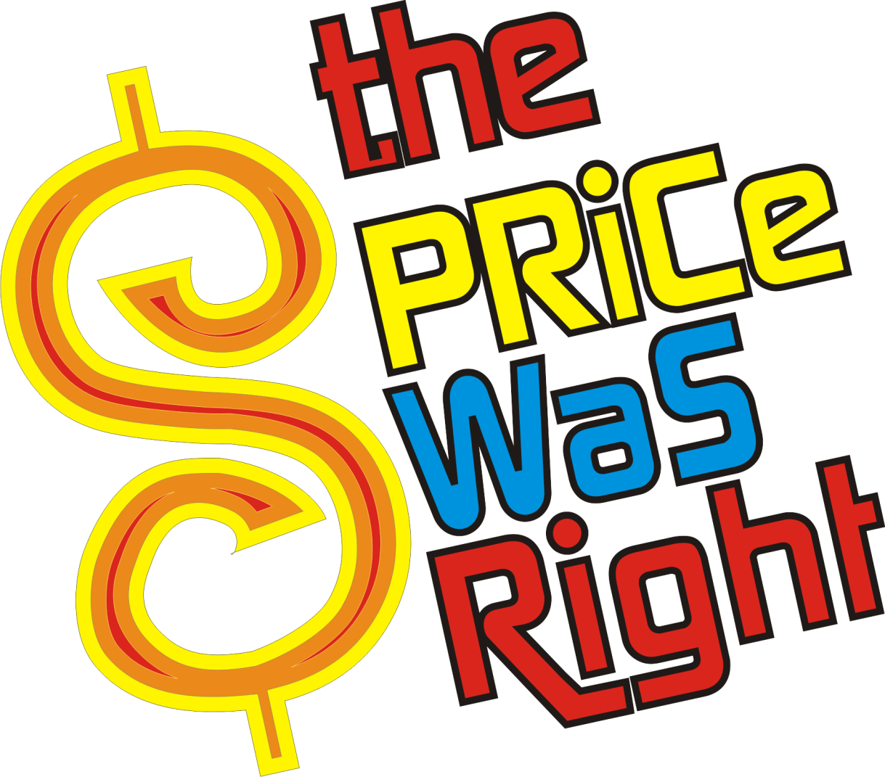
Notes:
Welcome to…THE PRICE WAS RIGHT! Let’s take a quick journey back in time to the year…

Slide 2
1983
Notes:
Does everyone remember the 80’s? They were a wild and crazy time. Here are some of the memorable events 1983. Many of these you will recall but some you might not know.

Slide 3
The Great Events
Notes:
Here are some of the most memorable events of that wonderful year.

Slide 4
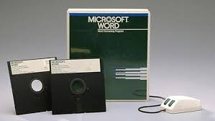
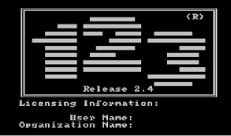
Microsoft Word & Lotus 123 released
Notes:
1983 was the early age of the Personal Computer. Lotus launched one of the most successful software programs in history called Lotus 123. This software was actually credited for starting the whole computer revolution. It was called “The Killer App” and made computers a necessary and useful part of people’s lives. Also in 1983 Microsoft launched a program that is still in use today called Word…which is now used by over 1.2 billion people worldwide.

Slide 5
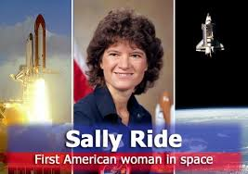
Sally Ride first US woman in space
Notes:
Dr. Sally Ride became the first US woman in space. She was a Mission Specialist on STS-7, the Space Shuttle Challenger, which launched from Kennedy Space Center, Florida, on June 18, 1983. The Russians beat us in the “equal opportunity” space category by 20 years. One June 16, 1963, Valentia Tereshkova was the first woman ever in space. She flew aboard Vostok 6.

Slide 6
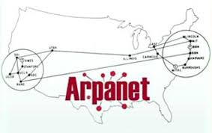
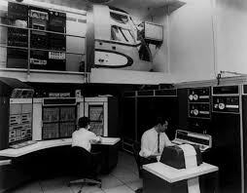
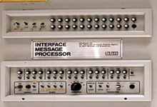
ARPANET becomes the Internet
Notes:
In 1983, the Advanced Research Projects Agency linked up a system of computers from several universities as part of something called ARPANET. This was the first group to adopt the new TCP/IP protocol which was backbone technical foundation of the internet.

Slide 7
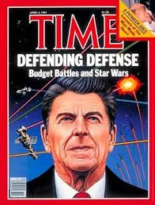
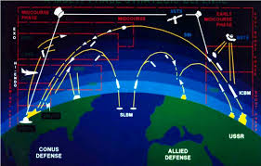
Reagan proposes “Star Wars” defense
Notes:
President Ronald Reagan in an attempt to end the cold war and make nuclear weapons obsolete, proposed the Strategic Defense Initiative or SDI. People very quickly dubbed this the “Star Wars Defense.” It was supposed to be a space-based system including lasers and particle beam weapons to intercept incoming enemy ballistic missiles. But it never really got off the ground.

Slide 8
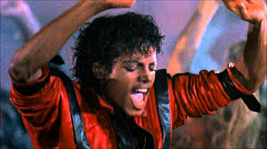
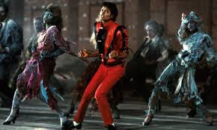
Michael Jackson releases Thriller
Notes:
Michael Jackson’s Thriller was the most popular record album of all time with 33 million copies sold. But recent data including streaming, showed that it was overtaken by The Eagles Greatest Hits at 38 million copies sold and downloaded!

Slide 9
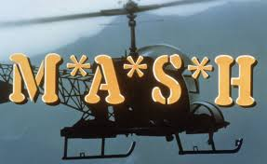
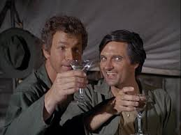
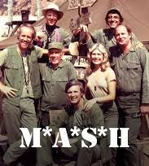
Final episode of M*A*S*H
Notes:
The final episode of MASH ended a successful 11-year run and was watched by over 77% of TV viewers. Excluding Superbowls, it was the most watched TV show of all time.

Slide 10
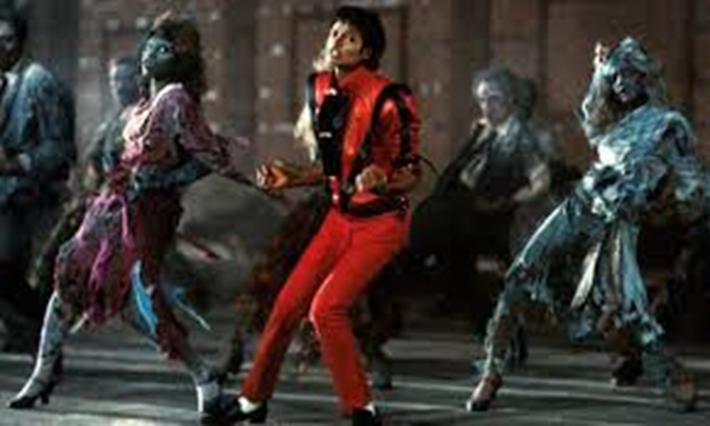
1983
Notes:
Those were some of the highlights. I’m sure you can all remember what you were doing in 1983. As for me…I was (you can tell a very brief story here if you wish.)
So now let’s play the game. Let’s look at a few popular items that people buy every day and see just how prices have changed in the last 37 years.

Slide 11
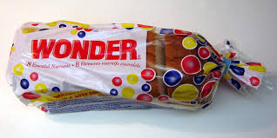
1983
Annual Inflation Rate
2022
$.66
4%
$2.50
In 20 Years - $5.35

Slide 12
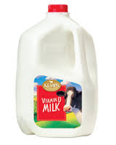
1983
Annual Inflation Rate
2022
$1.89
2%
$3.50
In 20 Years - $5.00
Notes:
A gallon of milk cost $1.89…today it’s closer to $3.50.

Slide 13
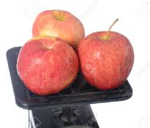
1983
Annual Inflation Rate
2022
$.39
4%
$1.50
In 20 Years - $3.24
Notes:
Most apples are around this price except Honeycrisps which are at $4.50 per pound. That would be a 7% inflation rate.

Slide 14
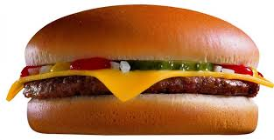
1983
Annual Inflation Rate
2022
$1.25
3%
$3.25
In 20 Years - $5.61
Notes:
You could grab a Big Mac in 1983 for $1.25. Today that’s over $3.

Slide 15
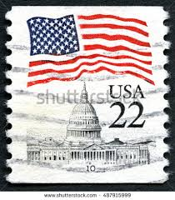
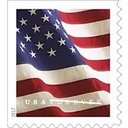
1983
Annual Inflation Rate
2022
22 cents
2.5%
58 cents
In 20 Years - $.95
Notes:
It’s interesting that postage stamp inflation is actually pretty low. If they had averaged just 3% they should cost more like $.65 now.

Slide 16
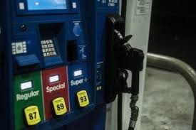
1983
Annual Inflation Rate
2022
$1.08
3.4%
$3.99
In 20 Years - $7.80
Notes:
A gallon of regular unleaded gas back in 1983 went for around $1. Today that’s almost $4. Again that’s a 3.4% inflation rate.

Slide 17
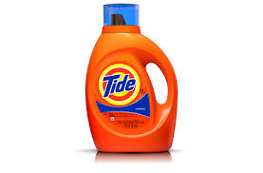
1983
Annual Inflation Rate
2022
$1.59
7%
$15.00
In 20 Years - $54.08
Notes:
The inflation rate on laundry detergent is very high. That might be because most detergents today are marketed as “concentrated” meaning you need to use far less liquid that older formulations.

Slide 18
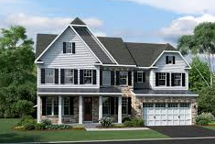
1983
Annual Inflation Rate
2022
$105,000
2.8%
$289,000
In 20 Years - $499,500
Notes:
The median home price in 1983 was $105,000 and today it’s up to over $289,000. That sounds like a huge jump, but again, it’s only a 3% inflation rate.

Slide 19
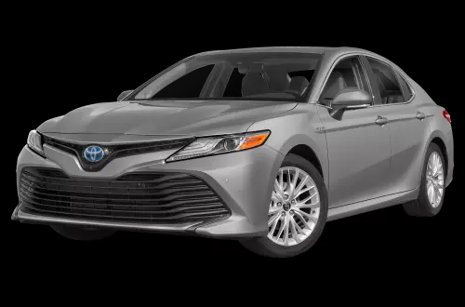
1983
Annual Inflation Rate
2022
$6,100
4%
$25,000
In 20 Years - $54,000
Notes:
Let’s call this the cost of basic transportation. A Toyota Camry in 1983 cost $6,100. Today the base price is around $25,000. And we are now slightly over 4% inflation.

Slide 20
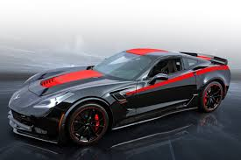
1983
Annual Inflation Rate
2022
$23,000
3%
$60,000
In 20 Years - $101,000
Notes:
For a sportier ride…your inflation rate is lower. A Corvette in 1983 cost $23,000 and you can grab one today for $59k…for a 3% inflation rate.

Slide 21
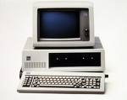
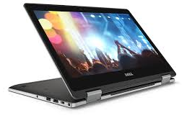
1983
Annual Inflation Rate
2022
$2,000
-2%
$940
Memory
Annual Deflation Rate
$100/mb
- 30%
$.24/Gb
Notes:
Personal computers are a fascinating item that have become commonplace in nearly everyone’s lives today. Back in 1983 you could get a top-of-the-line PC for around $2,000. But consider that back then the average computer had a 20 megabyte hard drive and 516K of RAM memory.
Modern computers not only cost less money…but even if you bought a really great PC today you are looking at infinitely greater capacity, processing power and memory. So from the perspective of computing power, you are looking at a DE-flation rate that’s averaged negative 30% per year.
ADVISOR NOTE:
(This is an interesting analysis that opens up a sidebar idea. Computers are a large part of increased worker productivity around the industrialized world. It’s fun to get people remembering their first computer purchase…it almost always gets a laugh.)

Slide 22
In 20 Years – computers may rule the world
Notes:
Of course, in 20 years computers may rule the world so we won’t have to worry about anything.

Slide 23
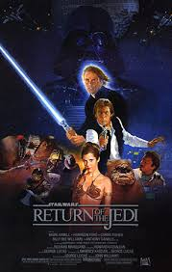
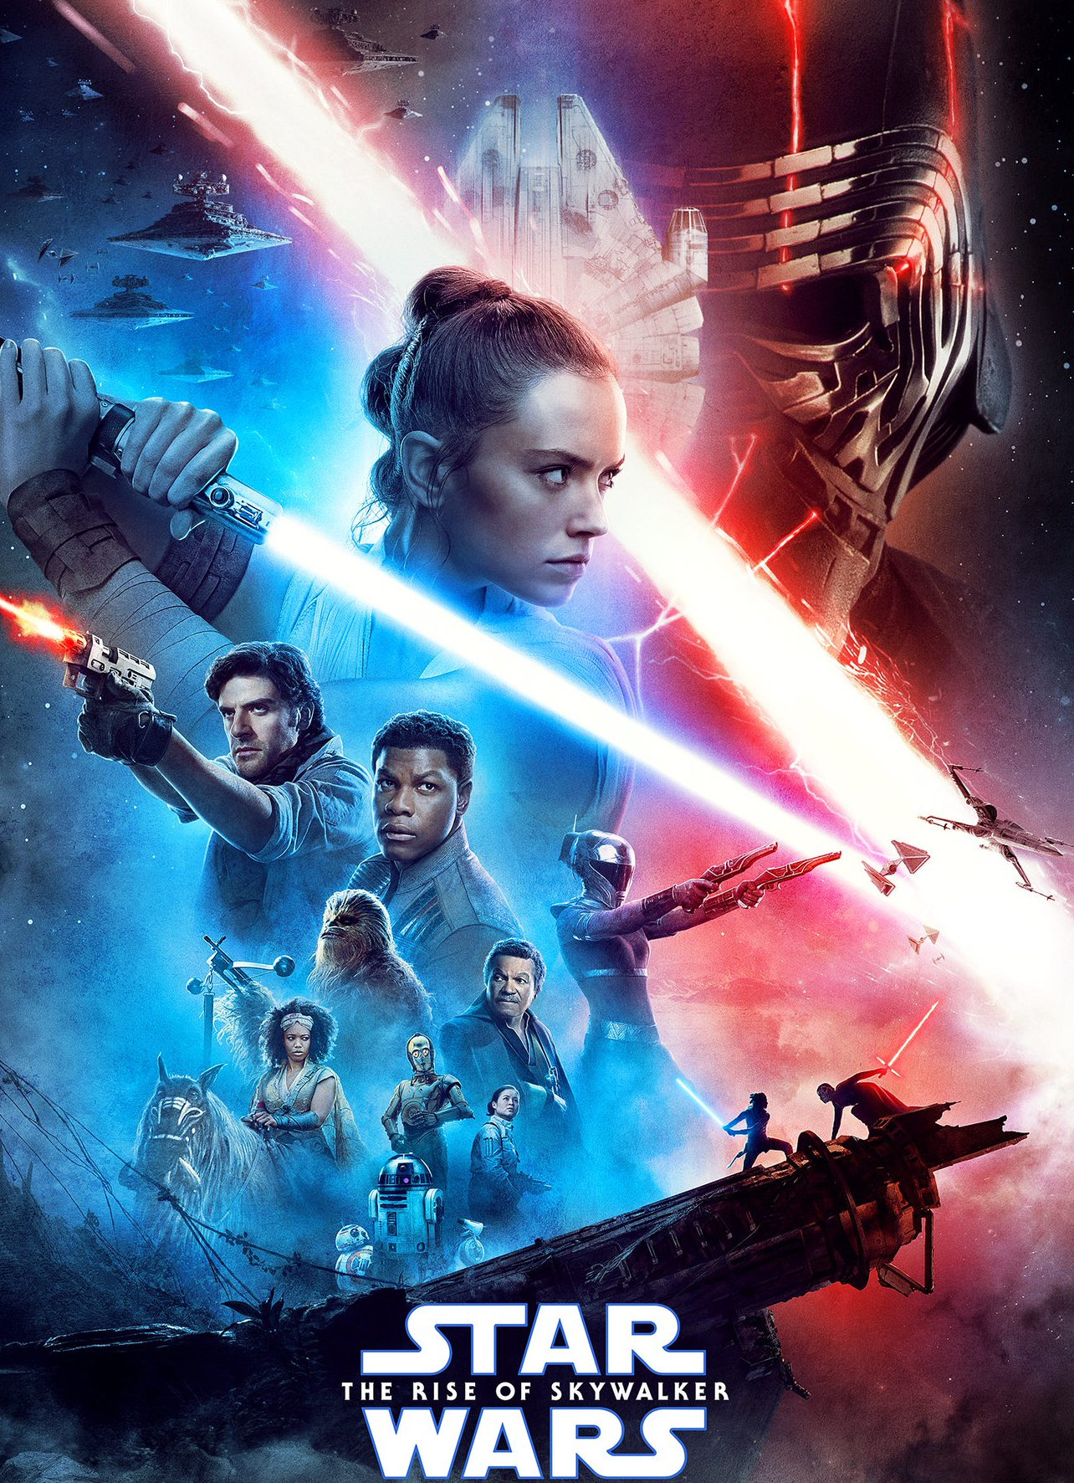
1983
Annual Inflation Rate
2022
$3.15
4%
$12.00
In 20 Years - $25.00
Notes:
The average movie ticket price in 1983 was $3.15. Today that closer to $10. And by the time you add in popcorn and soda you’re looking at $50 “date night” easily.

Slide 24
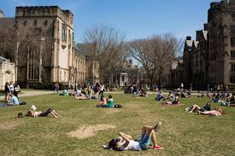
1983
Annual Inflation Rate
2022
$7,500
5%
$54,000
In 20 Years - $148,000
Average annual private college tuition, room & board
Notes:
The average annual cost for a private college tuition room and board has gone from $7500 up to $41000. A 4-year bachelor’s degree would have cost you $30,000 back then. Today that same degree would be over $160,000! Those numbers are pretty staggering and they add up to a much higher than normal inflation rate of 5% per year.

Slide 25
1983
Annual Inflation Rate
2022
$5,000
5%
$27,000
In 20 Years - $70,000
Notes:
The average wedding.

Slide 26
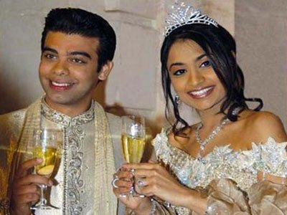
$66,000,000
Notes:
The most expensive wedding ever recorded.
#2 Vanisha Mittal and Amit Bhatia
The bill was $60 million in 2005, or $66 million when adjusted for inflation.
The bride was the beautiful daughter of billionaire steel-magnate Lakshmi Mittal.
The groom was a London-born i-banker, owner of Swordfish Investments.
The wedding featured invitations mailed in silver boxes, including plane tickets and rooms at a five-star Paris hotel. Five-day festivities at a 16th-century chateau and Versailles and a temporary wooden castle. Performances by Kylie Minogue, complementary Mouton Rothschild, and designer gift bags filled with jewels.

Slide 27
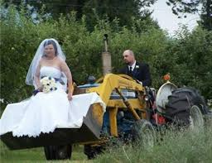
$375
Notes:
A slightly different alternative for a lot less money.

Slide 28
Dow Jones Industrial Average
1983
Annual Growth Rate
2022
1,258
9%
35,000
In 20 Years - 192,000
Notes:
ADVISOR NOTE:
(This can lead to a discussion about how significantly the equity market has consistently outpaced inflation over a very long time period. The number does not include reinvested dividends. )
(Also, if you need to change the number on the Dow to reflect current market levels closer to your actual presentation date, note that the average growth rate number will remain the same within a band from approx. 21,600 on the low end to 29,600 on the high end. If we dip below 21,600, you can round down to 8% per year. Above 29,700 you can round up to 10% per year. )

Slide 29
MINIMUM WAGE
1983
Annual Growth Rate
2022
$3.25
2.1%
$7.25
In 20 Years - $11.00
Notes:
In case you were curious…the Federal minimum wage in 1983 was $3.25. Today it’s $7.25. That’s an average annual increase of 2.1%...not even keeping up with inflation.

